Slide 1
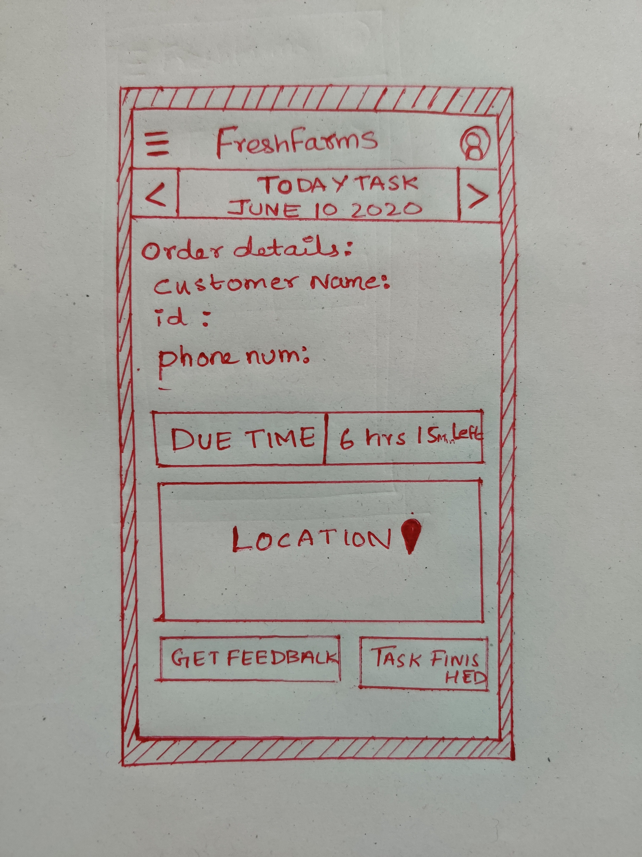
Design Sketch
Fresh farms- Delivery Menu
Mecline Jose 10 June 2020
Front Screen
What is it about?
Main page is the one stop destination of the app where Driver can complete the task assigned for him by the management
What are users supposed to do?
What else to know?
Only tasks for the particular day is shown on the main page thus ensuring not to confuse the delivery person
Design Principles applied
large menu buttons for easy clicking
Key Findings applied
Users don’t read; they scan
baker can chose by holding smart- phone in one hand

Slide 2
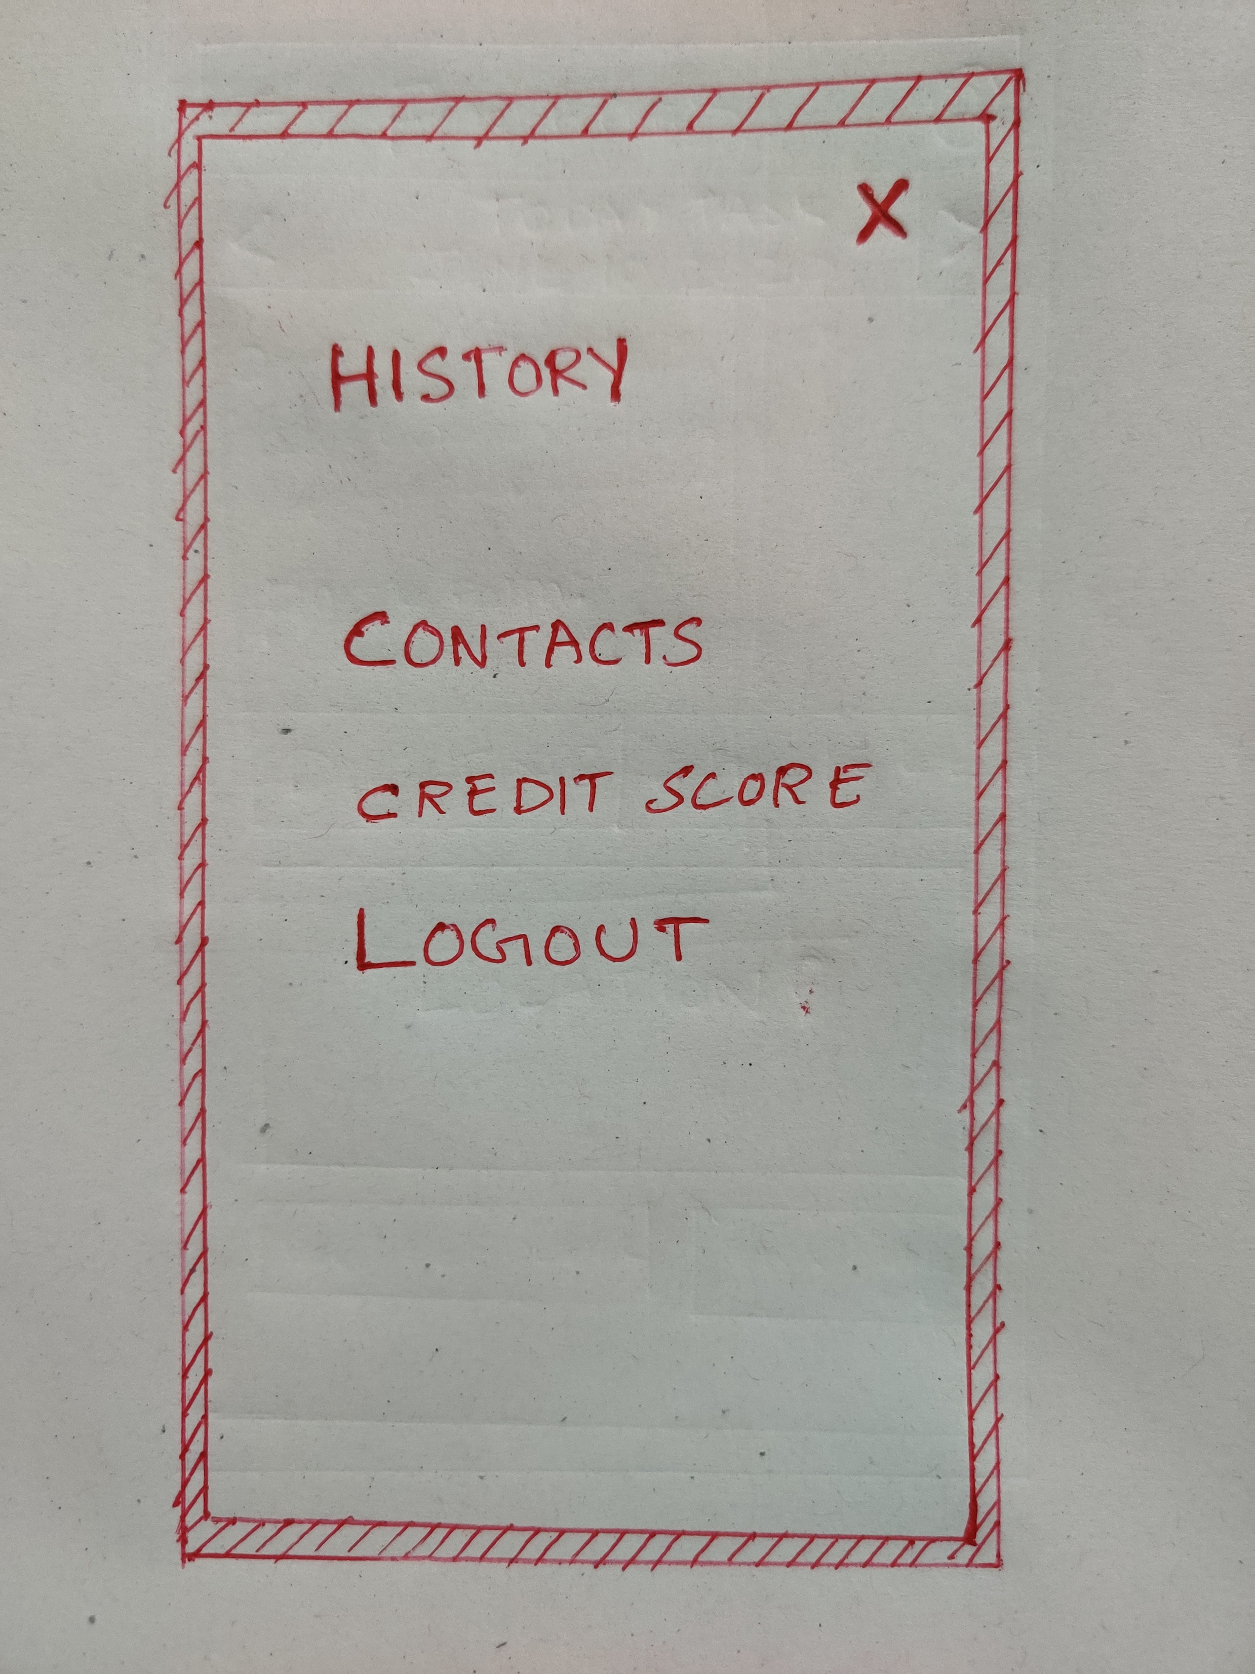
Hamburger Menu
What is it about?
First Page hamburger menu of the app Menu where driver has the access to contacts for management, his credit points and a log out option
What are users suppose to do?
Incase of emergency to make it more precise the driver can easily toggle the hamburger menu to access the contact page.
What else to know?
hamburger menu on top left corner (same as on front page)
return button top left

Slide 3
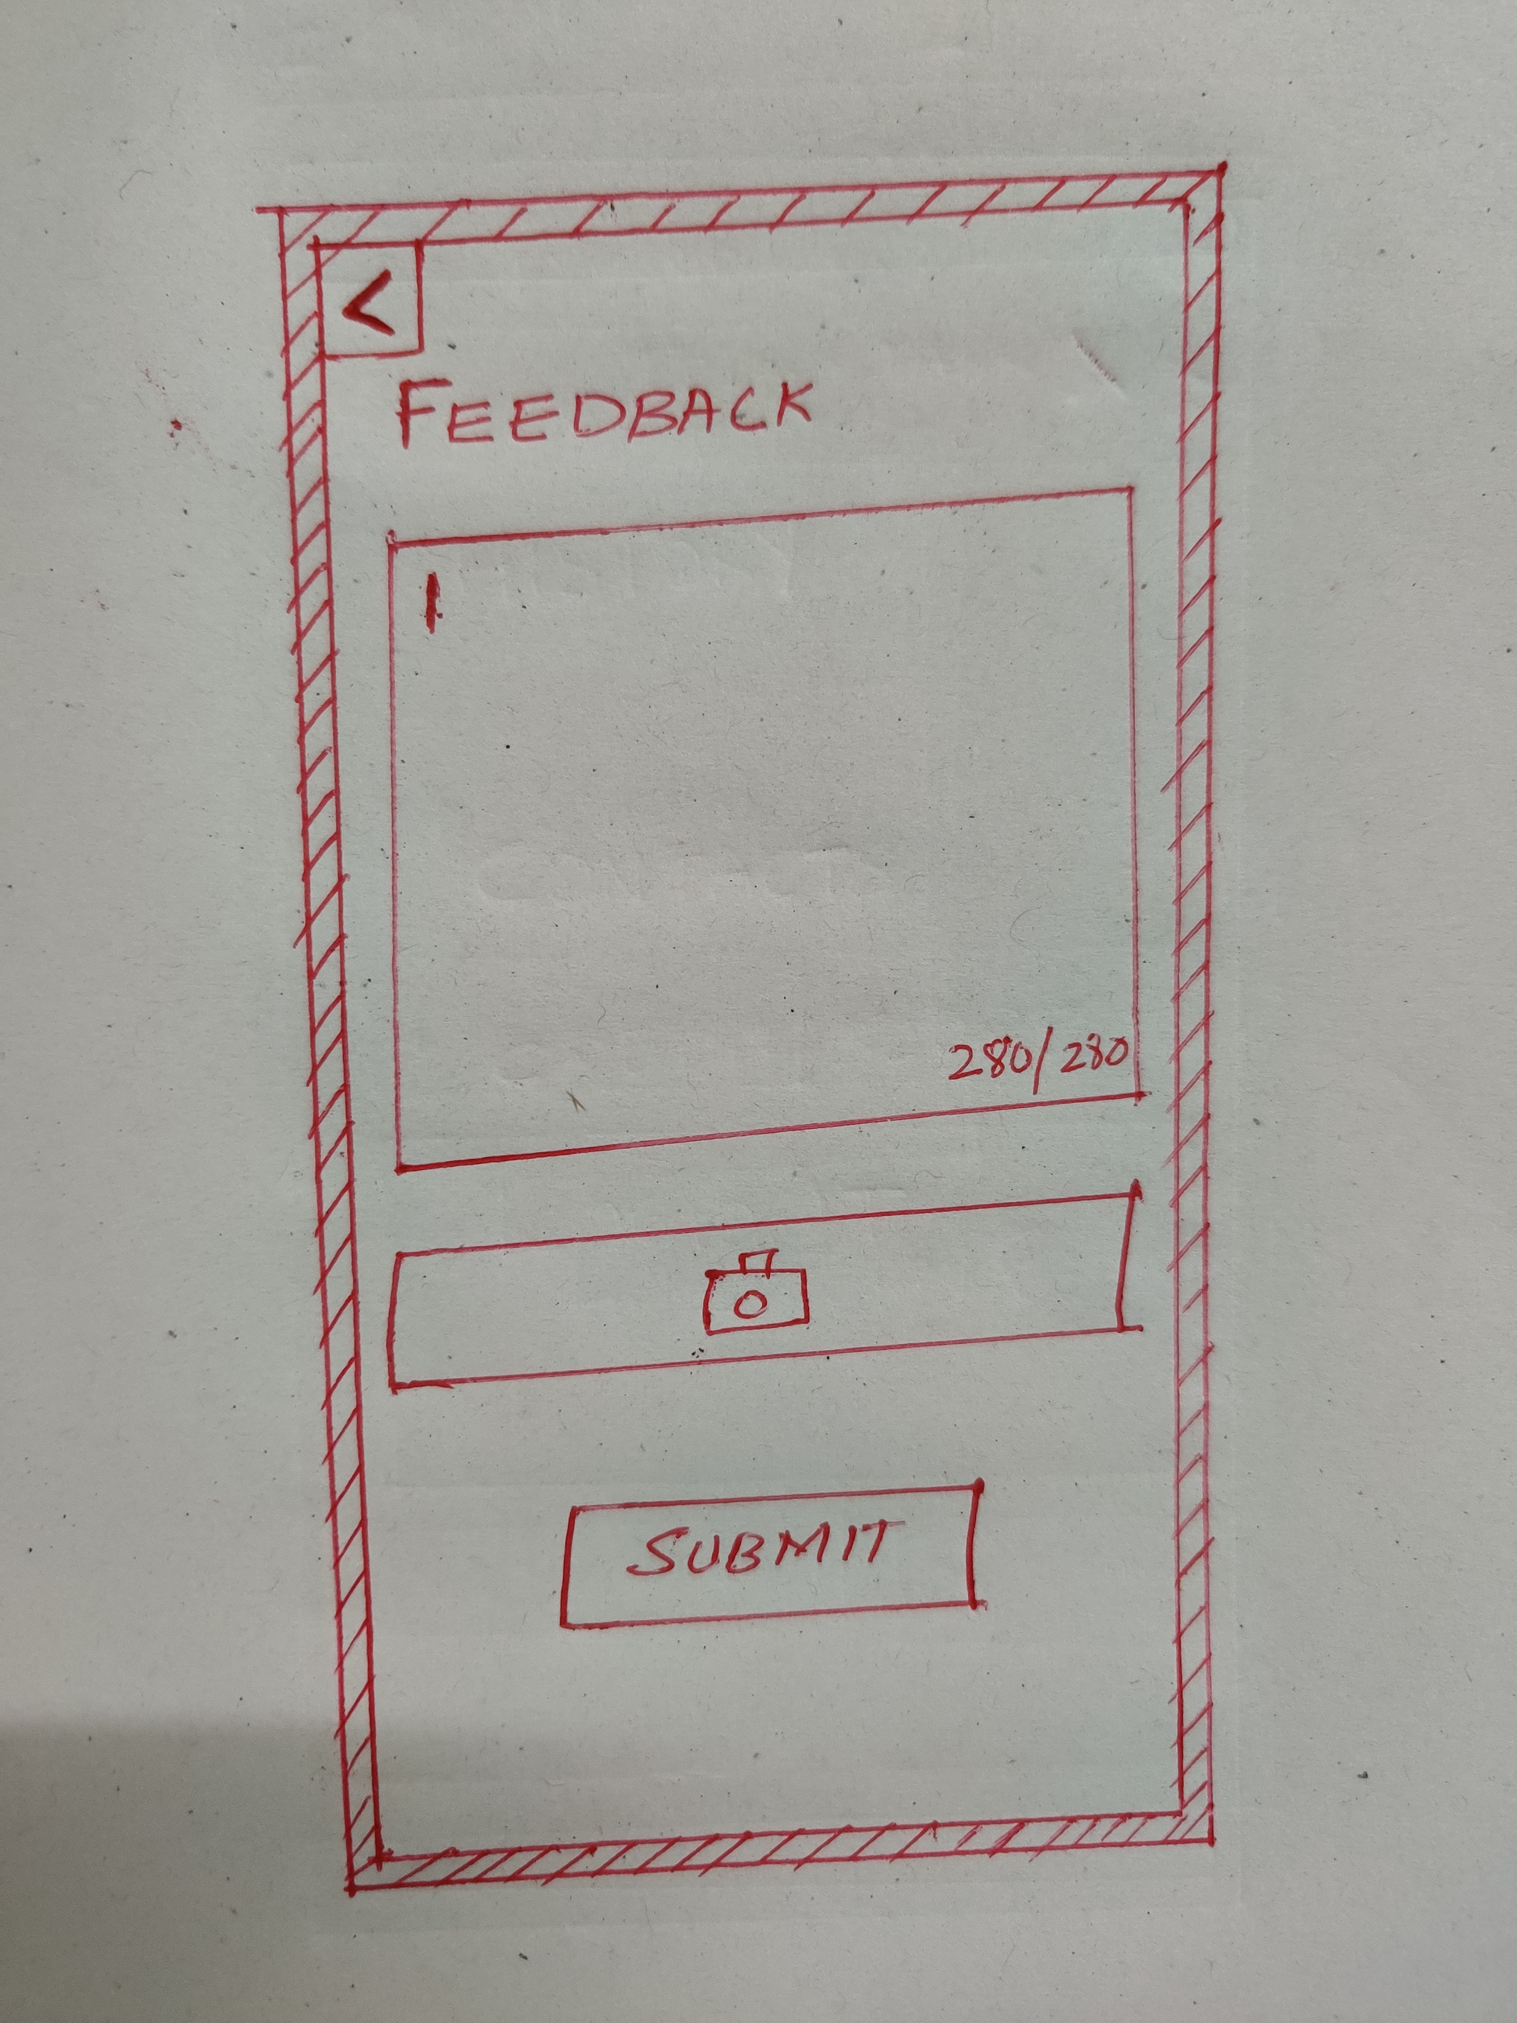
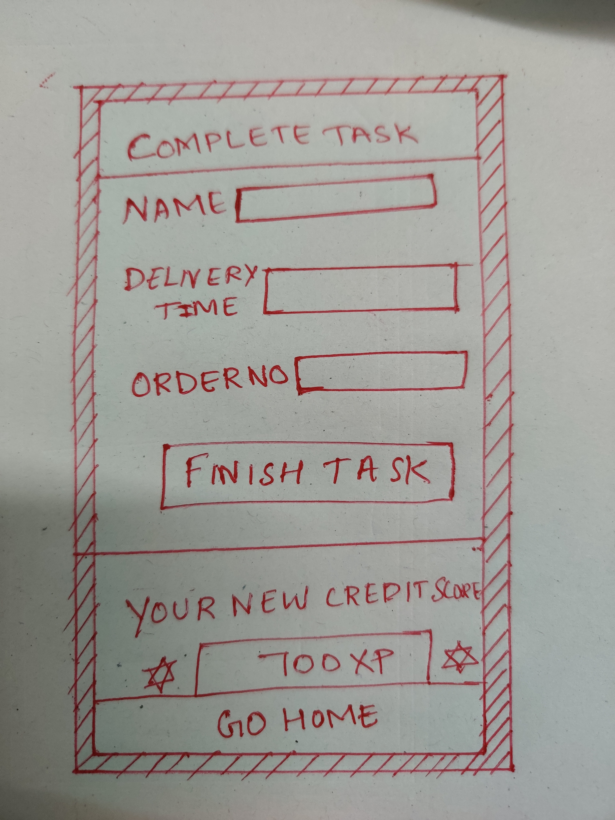
Customer Feedback Screen
Design Principles applied
people are used to that return (back) buttons are usually placed on the top left corner (past experience shapes expectations)
the task list reaches to the bottom and can be scrolled
emotional design: positive emojis after finished tasks
What else?
the feedback is now on the front screen and updates according to chosen the task
small preview picture of the task with short description can be uploaded
Submit button do the entry in database.
Completing the task screen
What is it about?
Credit score to motivate user
Checklist for finished subtasks with short description what to do
Name and delivery time order no are auto-filled as user is already on the workflow of one particular day’s task.
Based on the feedback a credit score will be given to the user which will added as incentive of the user monthly salary.
What else?
Go home button will turn the user to navigate into homepage
Design Principles applied
motivate user (emotional design)
Key Findings applied
The more the user do the tedious work the more he get the credit score which usually motivates the user and gives the user the choice to spread the task over time.

